Slide 1
BITS Pilani presentation
K.Anantharaman
Faculty CS Department
kanantharaman@wilp.bits-pilani.ac.in
01/02/25
01/02/25
S2-24_SEZG544 - Agile Software Process

Slide 2
SE ZG544 , Agile Software Process
Lecture No. 2 – Module-2 : Agile Software Development
01/02/25
S2-24_SEZG544 - Agile Software Process

Slide 3
Module-2 Topics
Project Development Life Cycle
Predictive life cycle
Iterative life cycle
Incremental life cycle
Agile/Adaptive life cycle
Spiral Model
Rational Unified Process
Early Agile Methods
Agile Mindset
01/02/25
S2-24_SEZG544 - Agile Software Process

Slide 4
Project Life cycle models
01/02/25
S2-24_SEZG544 - Agile Software Process

Slide 5
Life Cycle
The sequence of actions that must be performed in order to build a software system
Ideally thought to be a linear sequence: plan, design, build, test, deliver
This is the waterfall model
Realistically an iterative process
Iterative, Incremental, Agile Process
01/02/25
S2-24_SEZG544 - Agile Software Process

Slide 6
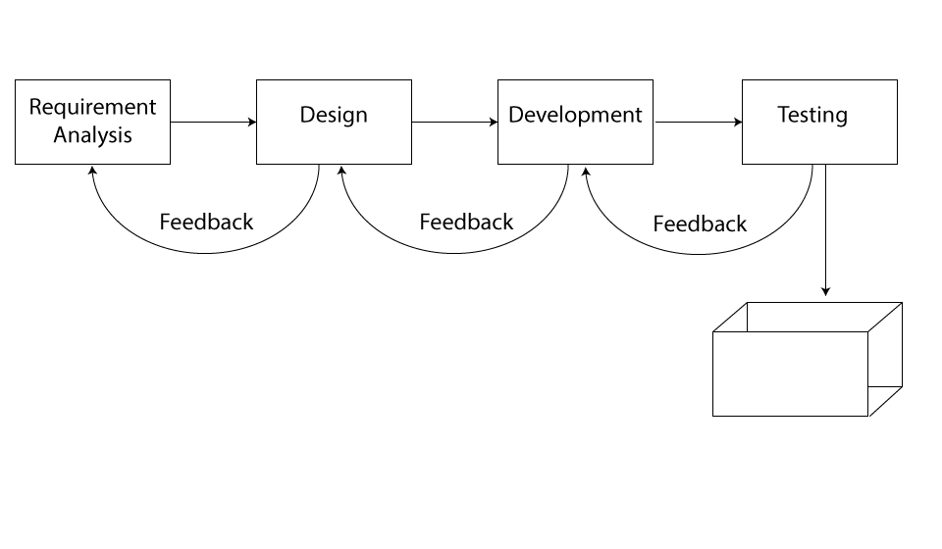
Predictive Project Development Life Cycle
(Fully Plan-Driven aka Waterfall)
A more traditional approach, with the bulk of planning occurring upfront, then executing in a single pass; a sequential process
Requirements/Scope is fixed
Single delivery
Goal: Manage Cost
Minimal feedback changes
Team is matured in estimation, technology etc..
Project governance model exists
Don’t expect long feedback cycle, If this happens, this lifecycle not suitable for the project
Plan
Source : https://www.izenbridge.com/blog/project-management-life-cycle-iterative-adaptive/
01/02/25
S2-24_SEZG544 - Agile Software Process

Slide 7
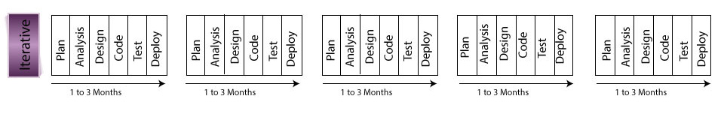
Iterative Project Development Life Cycle
Iterative development is when an attempt is made to develop a product with basic features, which then goes through a refinement process successively to add to the richness in features.
Plan
Goal: Correctness of Solution
Repeat until Correct
Show and receive feedback
Add richness or features
Single Final Delivery
Deliver result at the end of each iteration.
Result may not be usable
E.g. 1 year project divided into 3 to 4 iterations
Ref: https://www.izenbridge.com//
01/02/25
S2-24_SEZG544 - Agile Software Process

Slide 8
Examples of Iterative Development
When you are getting a customized coat made
You may be required to go for a trail to check for the fitting.
Even though the you may find the coat fitting well, you may not be able to use it as it has not been finished.
The fitting test was to give you an idea of the final product, which may not be ready for your consumption.
This is an example of iterative prototyping.
Developing a Website
Develop a prototype of the Website with basic functionality
Demo to Customer and receive feedback
Add to the richness or feature to the product in subsequent iteration
Source: https://www.izenbridge.com//
01/02/25
S2-24_SEZG544 - Agile Software Process

Slide 9
Incremental Life Cycle
In an incremental approach, one aims to build pieces of program/product that is complete in features and richness. Product increment is usable.
In this case, each functionality is built to its fullest and additional functionalities are added in an incremental fashion.
Plan
Example: You can compare this to a visit to restaurant. You get served starters first and on completion of its main course and then dessert. You get served incrementally and you consume it.
Source: https://www.izenbridge.com//
01/02/25
S2-24_SEZG544 - Agile Software Process

Slide 10
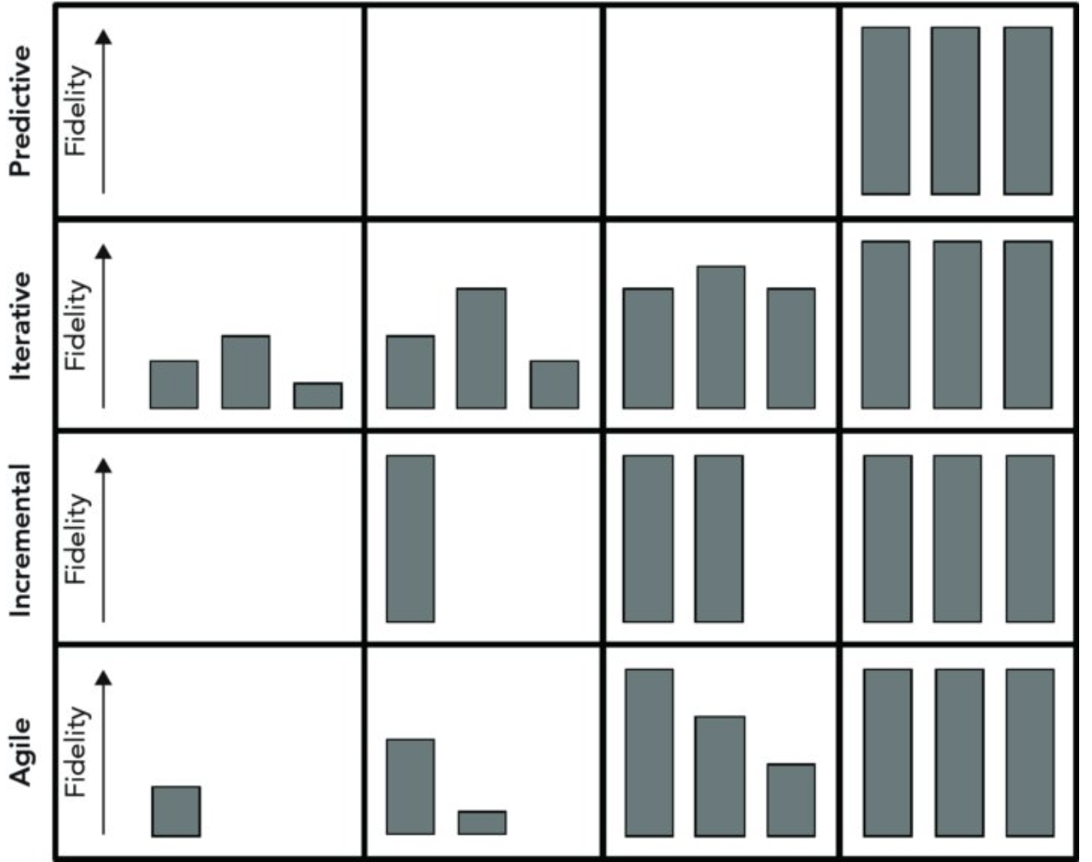
Project Life Cycle Models
Different development approaches add features and increase fidelity in different ways.
Fidelity: the degree of exactness with which something is copied or reproduced.
Timeline
Goals/Characteristics
Cost, Requirements-Fixed, Single Delivery
Accuracy/Correctness, final single delivery
Intermediate delivery – may no be usable
Example: Customized outfit/coat, Website
Accuracy/Correctness, Multiple Delivery,
Intermediate delivery –usable
Example: Visit to a restaurant
Accuracy/Correctness, Multiple Delivery,
Intermediate delivery –usable
Example: Game: Treasure Hunt with clues
Ref: Beginning Software Engineering by Rod Stephens
01/02/25
S2-24_SEZG544 - Agile Software Process

Slide 11
Agile Life Cycle Models
Iterative
Flow-Based
01/02/25
S2-24_SEZG544 - Agile Software Process

Slide 12
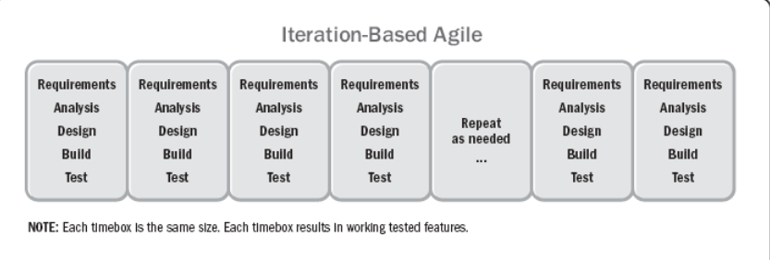
Agile/Adaptive Life Cycle-Iteration Based Agile
The project life cycle that is iterative and incremental
Plan
Fixed Time box : 1-4 weeks equal duration for each iteration Goals and Characteristics: Value, Multiple deliveries
Re.f: Agile Practice Guide (ENGLISH) by Project Management Institute Published by Project Management Institute, 2017 (Agile methodologies)I
01/02/25
S2-24_SEZG544 - Agile Software Process

Slide 13
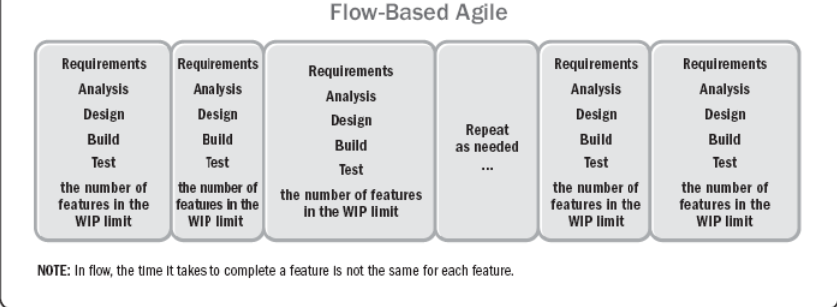
Agile/Adaptive Life Cycle-Flow-based Based Agile
The project life cycle that is iterative and incremental
Plan
Variable Time Box : Goals and Characteristics: Value, Multiple deliveries
Ref: Agile Practice Guide (ENGLISH) by Project Management Institute Published by Project Management Institute, 2017 (Agile methodologies)I
01/02/25
S2-24_SEZG544 - Agile Software Process

Slide 14
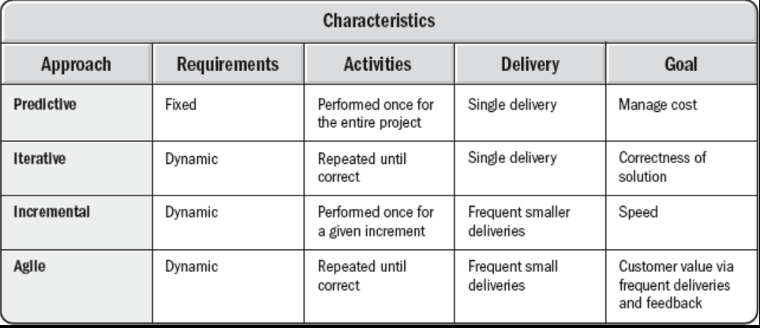
Project Life Cycles Characteristics
It should be emphasized that development life cycles are complex and multidimensional.
Often, the different phases in a given project employ different life cycles, just as distinct projects within a given program may each be executed differently.
Ref: Agile Practice Guide (ENGLISH) by Project Management Institute Published by Project Management Institute, 2017 (Agile methodologies)I
01/02/25
S2-24_SEZG544 - Agile Software Process

Slide 15
Q&A
Set1
01/02/25
S2-24_SEZG544 - Agile Software Process

Slide 16
Some Popular Iteration Models
01/02/25
S2-24_SEZG544 - Agile Software Process

Slide 17
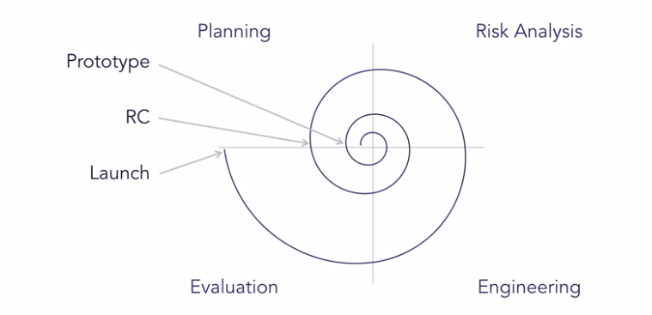
Spiral Risk Driven Customer driven Planning
Developed by Barry Boehm, 1986.
Easier management of risks (Theme)
Mix of water fall and iterations
Y-Axis represents Cost
X-Axis represents Review
Prototype-1, Prototype-2 ….
Operational Prototype
Final Release
Four Phases
Planning: Requirements Identification and Analysis
Risk Analysis: Risk identification, Prioritization and Mitigation
Engineering: Coding, Testing and Deployment
Evaluation: Review and plan for next iteration
01/02/25
Ref: Agile Software Development with Shashi Shekhar,LinkedIn Learning
S2-24_SEZG544 - Agile Software Process

Slide 18
Rational Unified Process (RUP)
1990s, Rational Software developed the Rational Unified Process as a software process product.
IBM acquired Rational software in 2006 (era of OOAD,UML)
Rational Unified Process, or RUP, was an attempt to come up with a comprehensive iterative software development process.
RUP is essentially a large pool of knowledge. RUP consists of artifacts, processes, templates, phases, and disciplines.
RUP is defined to be a customizable process that would work for building small, medium, and large software systems.
Ref: Agile Software Development with Shashi Shekhar,LinkedIn Learning
01/02/25
S2-24_SEZG544 - Agile Software Process

Slide 19
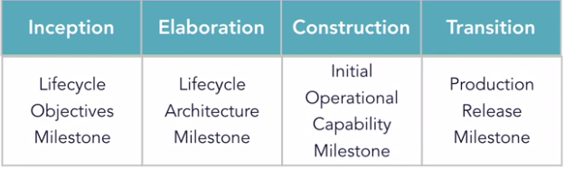
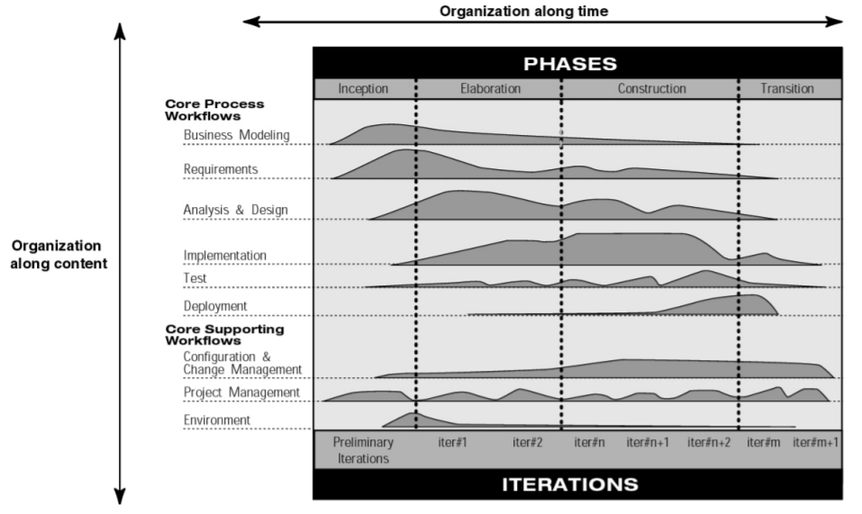
RUP Iterative Model
X-Axis: RUP Phases, Dynamic
Y-Axis: Organization Process, Static
01/02/25
Ref: Agile Software Development with Shashi Shekhar,LinkedIn Learning
S2-24_SEZG544 - Agile Software Process

Slide 20
Early Agile Methods
01/02/25
S2-24_SEZG544 - Agile Software Process

Slide 21
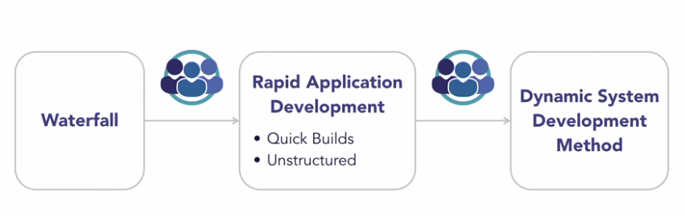
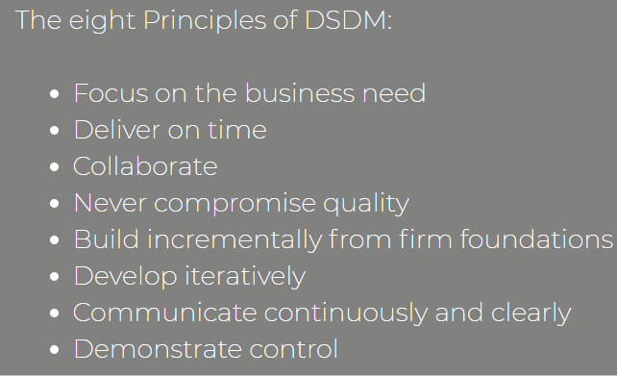
Dynamic System Development Method (DSDM)
Developed in 1994
Era where organization slowly moving away from waterfall model
During this time RAD model came into existence
RAD approach is very agile but has no formal process
DSDM was formed by group of organizations
Project development standard in Europe for several years
In 2016 DSDM is changed its name to Agile business consortium
https://www.agilebusiness.org/
Source:Agile Lynda.com, Agilebusiness.com
01/02/25
S2-24_SEZG544 - Agile Software Process

Slide 22
Feature Driven Development (FDD)
Lightweight Agile process
Software is a collection of features
Software feature =“working functionality with business value”
Deliver working software (working feature)
Short iterative process with five activities
Develop over all, Build Feature list, Plan by feature, Design by Feature Build by feature
FDD is used to build large banking systems successfully
Feature Example:
Calculate monthly interest on the account balance
(action) (result) (object)
Ref: Agile Software Development with Shashi Shekhar,LinkedIn Learning
01/02/25
S2-24_SEZG544 - Agile Software Process

Slide 23
Crystal Method- Selecting a Model
Life
Essential Money
Discretionary Money
Comfort
 | 1-6 | 7-20 | 21-40 | 41-80 | 81-200 | Large
Criticality
Team Size
Different crystal methodologies based on team size.
If Criticality increases tweak the process to address the extra risk
Comfort: System malfunction
Discretionary Money: Extra savings
Essential Money: Revenue loss
Life: Loss of life , Critical software
Crystal methods are people-centric, light-weight, and highly flexible. Focus on People, Interactions,Colloborations.
Developed by Alistair Cockburn , 1991
01/02/25
Ref: Agile Software Development with Shashi Shekhar,LinkedIn Learning
S2-24_SEZG544 - Agile Software Process

Slide 24
Q&A
Set2
01/02/25
S2-24_SEZG544 - Agile Software Process

Slide 25
Project Classifications/Decision making models
01/02/25
S2-24_SEZG544 - Agile Software Process

Slide 26
Decision Making Models
Stacey's Complexity Model: Organizes problems into four categories (Simple, Complicated, Complex, Chaotic) based on their level of clarity and predictability.
Cynefin framework: Helps leaders make decisions by categorizing problems into domains (Simple, Complicated, Complex, Chaotic, Disorder) based on their nature and relationships between cause and effect.
Use cases of these Models:
Leaders can use these models to understand the nature of a problem they face and make appropriate decisions.
Project managers can use the models to select the most suitable approach based on the complexity of their projects.
Teams can use the frameworks to recognize when a problem is shifting from one domain to another, requiring a change in their approach.

Slide 27
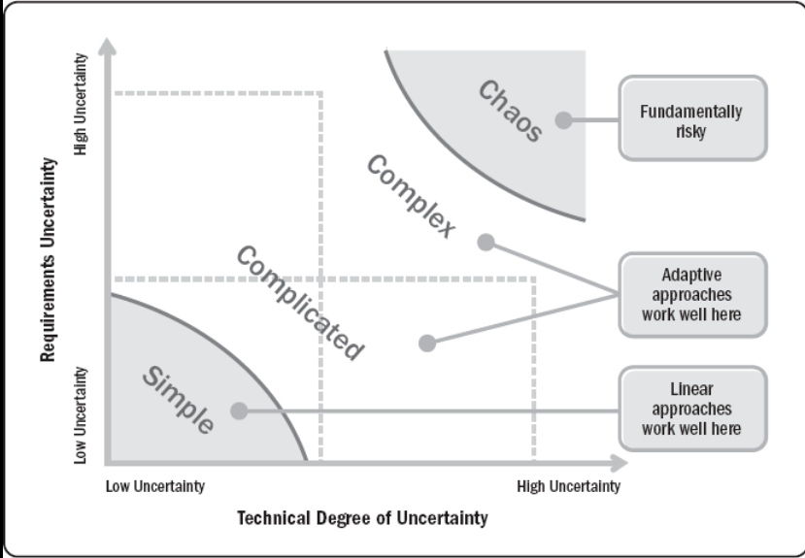
Agile Suitability - Project Environment
Stacey’s Complexity Model
Project Examples:
Simple: Setting up a new employee onboarding process with clear steps to follow.
Complicated: Building a large-scale IT infrastructure with the help of experienced IT consultants.
Complex: Developing a new product in a rapidly changing market, requiring continuous iteration and learning.
Chaotic: Crisis management during a natural disaster or cyber-attack.
Ref: Agile Practice Guide (ENGLISH) by Project Management Institute Published by Project Management Institute, 2017 (Agile methodologies)
01/02/25
Agile Software Process SE ZG544 S1-22-23

Slide 28
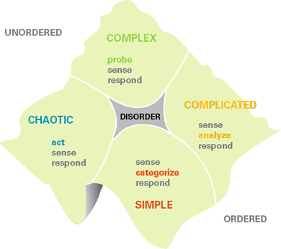
Cynefin framework - A Leader’s Framework for Decision Making
Developed in the early 2000s by David Snodown
Pronounced as: kun-ev-in
Emergent
Eg: Developing an AI-powered chatbot
Cause # effect
Good/Standard Practice
Eg. Building a customer relationship management (CRM) system with extensive customization options for different clients.
AR Product:
Eg: No Skills
Cause == effect
Chaos
Novel
Responding to a massive
security breach in a cloud-based service
Cause = effect
Best Practice
Eg: Setting up a basic website for a small business,
01/02/25
Agile Software Process SE ZG544 S1-22-23

Slide 29
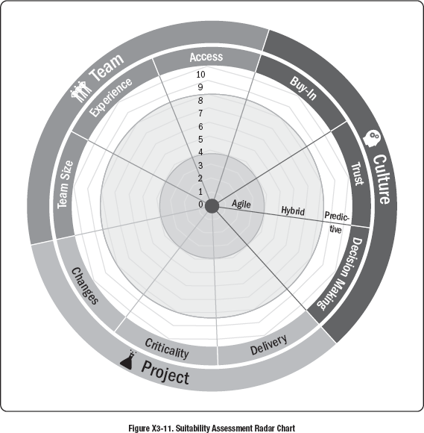
Agile Suitability Filter
Attributes | Assessment (wrt Agile)
Buy-In | 0-Yes, 5-Partial, 10-No
Trust | 0-Yes, 5-Probabily, 10-No
Decision Making | 0-Yes, 5-Probably, 10-Unlikely
Incremental Delivery | 0-Yes, 5-Maybe/Sometimes, 10-Unlikely
Criticality | 0-Low, 5-Medium, 10-High
Changes | 0-High, 5-Medium, 10-Low
Team Size | 1-Small (<10), 5-Medium (>80), 10- Large (>200)
Experience | 0-Yes, 5-Partial, 10-No
Access to business Info/Project Info | 0-Yes, 5-Partial, 10-No
01/02/25
Agile Software Process SE ZG544 S1-22-23

Slide 30
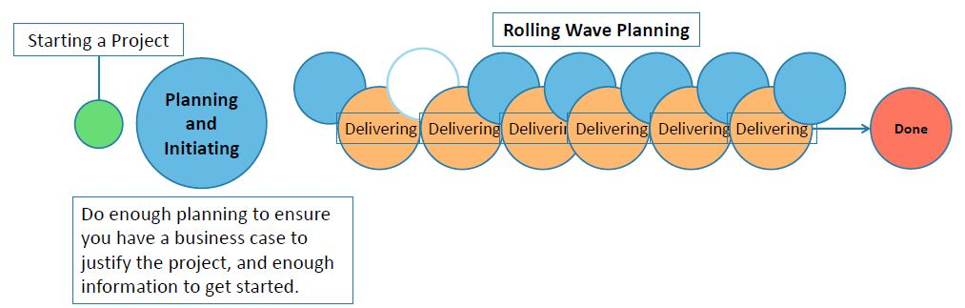
Rolling Wave Planning or Progressive Elaboration
https://www.simplilearn.com/adaptive-planning-part-1-tutorial
01/02/25
Agile Software Process SE ZG544 S1-22-23

Slide 31
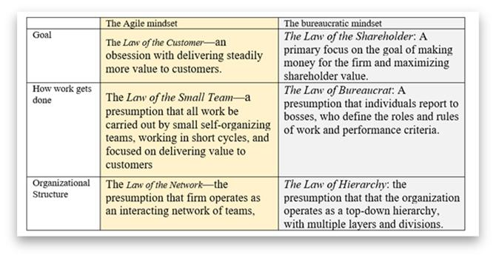
Mindset
Source: https://www.forbes.com/sites/stevedenning/2019/08/13/understanding-the-agile-mindset/?sh=5a66a5545c17
01/02/25

Slide 32
Agile Mindset
01/02/25

Slide 33
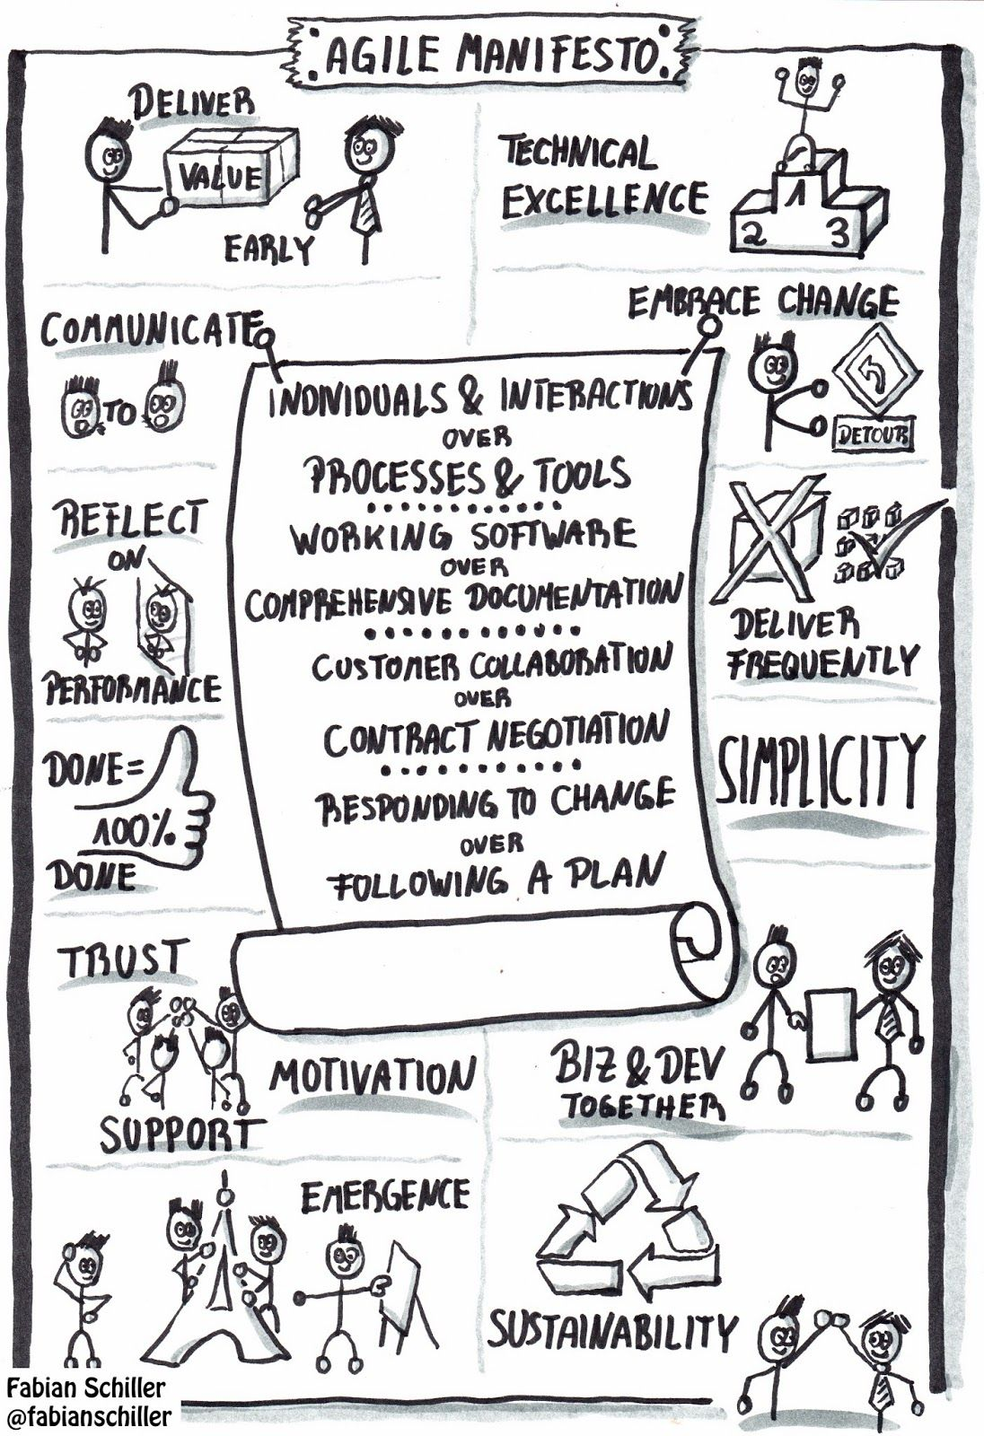
Agile Manifesto & Principles
(Basis of Agile Mindset)
In 2001, a group of software and project experts got together to talk about what their successful projects had in common.
This group created the Agile Manifesto, a statement of values for successful software development
Then they wrote Agile Principles
We will discuss this topic in more detail in the next module
01/02/25

Slide 34
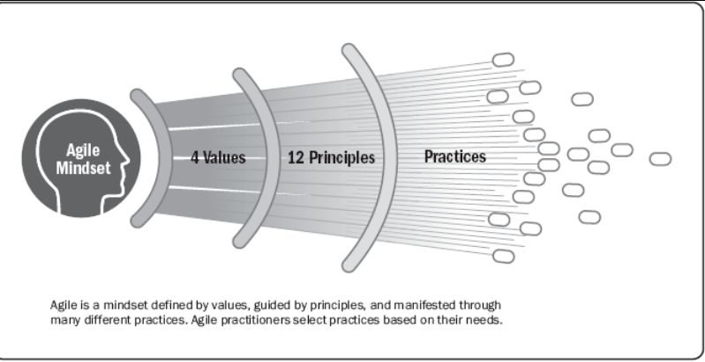
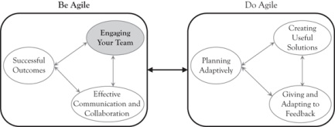
Agile Mindset
(Be Agile and Do Agile)
An Agile mindset implies that an organization or person has absorbed Agile to the extent that it becomes part of their ‘identity’, i.e. their ‘business-as-usual’ state and the default way they interact with the world.
01/02/25

Slide 35
Agile Mindset …
It is important to understand that, for Agile to be successful, the right mindset is equally important than merely implementing Agile tools, practices or principles.
For example, having a visual board does not necessarily mean that a team is Agile.
Experiments have shown that people can strongly influence each other to adopt or reject an Agile mindset .
01/02/25

Slide 36
Agile Mindset …
Agile is a journey, not a destination
Teams become more Agile by embedding the Agile mindset deeper inside themselves and the organization.
This process is facilitated by applying Agile values, practices, principles and so on.
01/02/25

Slide 37
Agile is not just a set of rituals
Where teams may understand what to do, but don’t understand why they are doing it. This will result in partial success.
If this happens teams tend to use Agile practices for a short period of time, but over the longer term they fall back into their previous ways of working.
Because they don’t understand why they are doing what they are doing.
01/02/25

Slide 38
Agile is not just techniques
People often prefer to pick out the elements of a framework they can easily understand rather than understanding an entire framework and why it should be implemented.
Some Agile frameworks will only work effectively if all the key activities, roles and artefacts of the framework are in place.
So, for example, people might think that just prioritizing stories within a backlog is the same as ‘being Agile’, instead of it being just one part of the whole. Additionally, while prioritization of stories is indeed a core practice in Agile, it is also used in more traditional non-Agile delivery approaches.
01/02/25

Slide 39
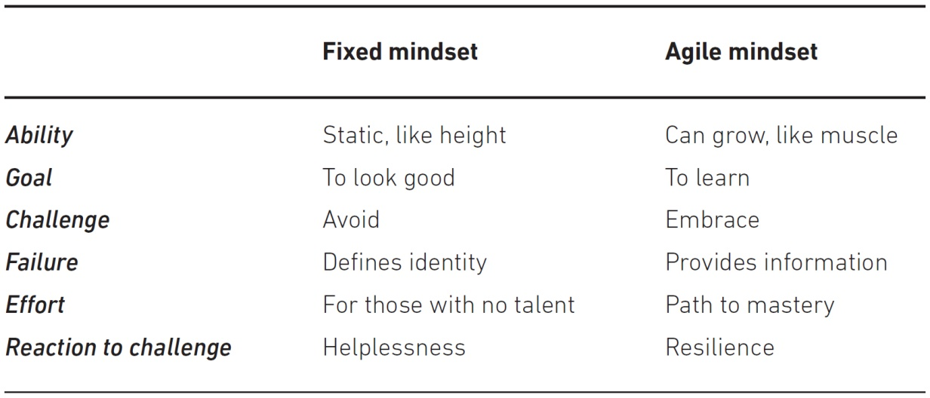
What is being Agile? Mindset?
The most important aspect of an Agile mindset is understanding that Agile is neither just a set of rituals that are repeated, nor is it merely based on techniques.
Source: Agile Practice guide, PMI
01/02/25

Slide 40
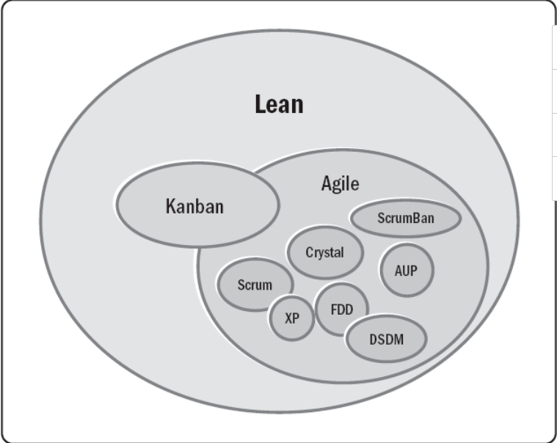
Agile is a blanket of many approaches
Is agile an approach, a method, a practice, a technique, or a framework?
Any or all of these terms could apply depending on the situation.
Source: Agile Practice guide, PMI
01/02/25

Slide 41
Two Approaches to fulfill Agile Values and Principles
Adopt a formal agile approach (Designed and Proven)
Take time to understand the agile approaches before changing or tailoring them. Premature and haphazard tailoring can limit benefits.
Implement changes to project practices in a manner that fits the project context to achieve progress on a core value or principle.
Use time boxes to create features
Specific techniques to iteratively refine features.
Consider dividing up one large project into several releases
The end goal is not to be agile for its own sake, but rather to deliver a continuous flow of value to customers and achieve better business outcomes.
Source: Agile Practice guide, PMI
01/02/25

Slide 42
Q&A
Set 3
01/02/25
S2-24_SEZG544 - Agile Software Process

Slide 43
Delivery Environments and Agile Suitability
01/02/25
Agile Software Process SE SG544 S1-22-23

Slide 44
Delivery Environments
The environment within which Project/Product delivery will occur should largely drive the delivery and governance framework(s) that will be implemented.
For example, in a delivery environment where high variability is likely to be encountered (like IT product development), an Agile framework would be suited
In an environment where variability is likely to be low, a more defined process may be more suited (like ‘Waterfall’).
Ref: Agile Foundations - Principles, practices and frameworks by Peter Measey
01/02/25
Agile Software Process SE SG544 S1-22-23

Slide 45
Understanding the Delivery Environments:
Stacey’s Complexity Model
Simple Environment: Use defined Process like Waterfall
Complicated/Complex/Anarchy Environment: Use Empirical process like Agile. Example: New IT product development
When trying to understand types of environments, it is important to take into account the amount of innovation that is being sought or considered for a new product or service. As the level of innovation increases, so does the move towards complexity, and a high variability is likely to be present.
Ref: Agile Foundations - Principles, practices and frameworks by Peter Measey
01/02/25
Agile Software Process SE SG544 S1-22-23

Slide 46
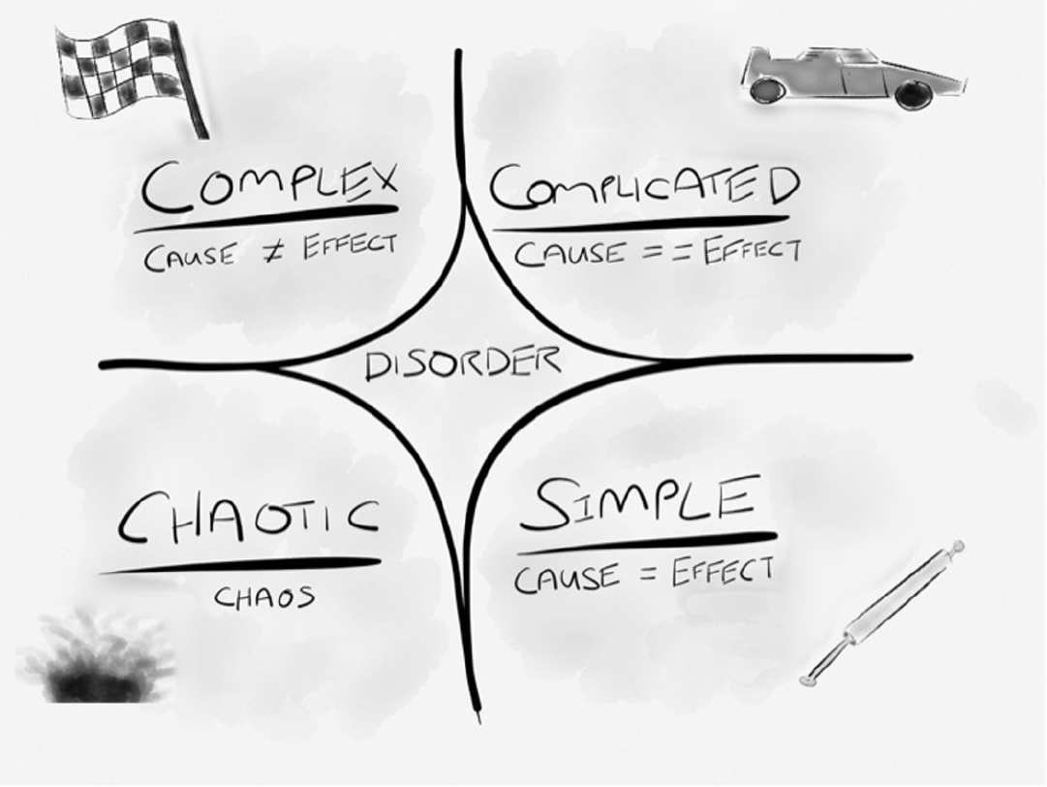
Cynefin Framework for Decision Making
The Cynefin framework (Snowdon and Boone, 2007) gives an alternative framework for determining and understanding simple, complicated and complex environments
The central idea of the framework is to offer decision-makers a “sense of place” to view their perceptions in dealing with a situation or problem. Not all situations are equal, and this framework helps to define which response is required for a given situation or problem.
https://txm.com/making-sense-problems-cynefin-framework/
01/02/25
Agile Software Process SE SG544 S1-22-23

Slide 47
Cynefin identifies five domains:
Simple (obvious) domain:
In this domain the relationship between cause and effect is obvious and therefore it is relatively easy to predict an outcome. In this domain predictive planning works well as everything is pretty well understood. Teams can define up front how best to deliver a product, and they can then create a defined approach and plan. The Waterfall model works well in these types of environments with little variability.
Complicated domain
In this domain, the relationship between cause and effect becomes less obvious; however, after a period of analysis it should generally be possible to come up with a defined approach and plan. Such a plan will normally include contingency to take into account the fact that the analysis may be flawed by a certain amount. Again, the Waterfall model is suitable for this environment as there is an element of definition up front; however, a more empirical process, like Agile, may be more suited.
https://txm.com/making-sense-problems-cynefin-framework/
01/02/25
Agile Software Process SE SG544 S1-22-23

Slide 48
Cynefin identifies five domains:
Complex domain
In this domain the relationship between cause and effect starts to break down as there tend to be many different factors that drive the effect. While it may be possible to identify retrospectively a relationship between cause and effect, the cause of an effect today may be different to the cause of the same effect tomorrow. Creating a defined up-front approach and plan is not effective within this domain and therefore an Agile way of working is recommended.
Chaotic domain
In this domain, there is no recognizable relationship between cause and effect at all, making it impossible to define an approach up front or to plan at all. Instead, teams must perform experiments (e.g. prototyping, modelling) with the aim to move into one of the other less chaotic domains. An Agile approach can work in this domain, for example Kanban which does not require up-front plans.
Disorder
Being in this environment means that it is impossible to determine which domain definition applies. This is the most risky domain as teams tend to fall into their default way of working, which may prove unsuitable for what they are trying to achieve.
https://txm.com/making-sense-problems-cynefin-framework/
01/02/25
Agile Software Process SE SG544 S1-22-23

Slide 49
A Note on
Cynefin identifies five domains:
During a product’s development and evolution there may be elements of delivery spread across all the Cynefin domains at the same time.
There may be aspects of a large system that are simple, while others may be in the complicated domain; and there could also be areas where innovation is necessary and which require a move towards the complex or even towards the chaotic domain.
https://txm.com/making-sense-problems-cynefin-framework/
01/02/25
Agile Software Process SE SG544 S1-22-23

Slide 50
Thank you
01/02/25
S2-24_SEZG544 - Agile Software Process

